Slide 1
BMI203 Paper Talk
The dynamics and regulators of cell fate decisions are
revealed by pseudotemporal ordering of single cells
Trapnell et al. Nature Biotechnology
Daniel Wong

Slide 2
Background
Defining transcriptional dynamics of a temporal process (like cell differentiation) is hard
Cell proliferation, differentiation, and reprogramming are governed by both time and complex cell-cell signaling
Current solutions:
time series gene expression of bulk cells
single cell proteomics
Notes:
(Read first bullet)
Hard because of high variability in gene expression between individual cells in different phases of cell cycle
(read second bullet)
For instance during differentiation, each cell makes its own independent fate decisions and can execute the same sequence of transcriptional changes over highly variable time scales
(read third bullet)
There are limitations of time series in that it has difficulty distinguishing between early and late phases of a transcriptional cascade, also averaging effects can mask the discovery of correlated transcription factors
Single cell proteomics rely on a priori knowledge of key markers – so it makes finding de novo markers difficult

Slide 3
Monocle
Solution is called “monocle”
Hypothesis: deriving whole-transcriptome profiles of single cells with an unsupervised algorithm would improve temporal resolution during differentiation without a priori knowledge of marker genes
Notes:
So this group came up with a new algorithm they call “monocle” – not even an acronym for anything like how most biotech papers come up with a stretchy name, just called monocle
(State hypothesis)

Slide 4
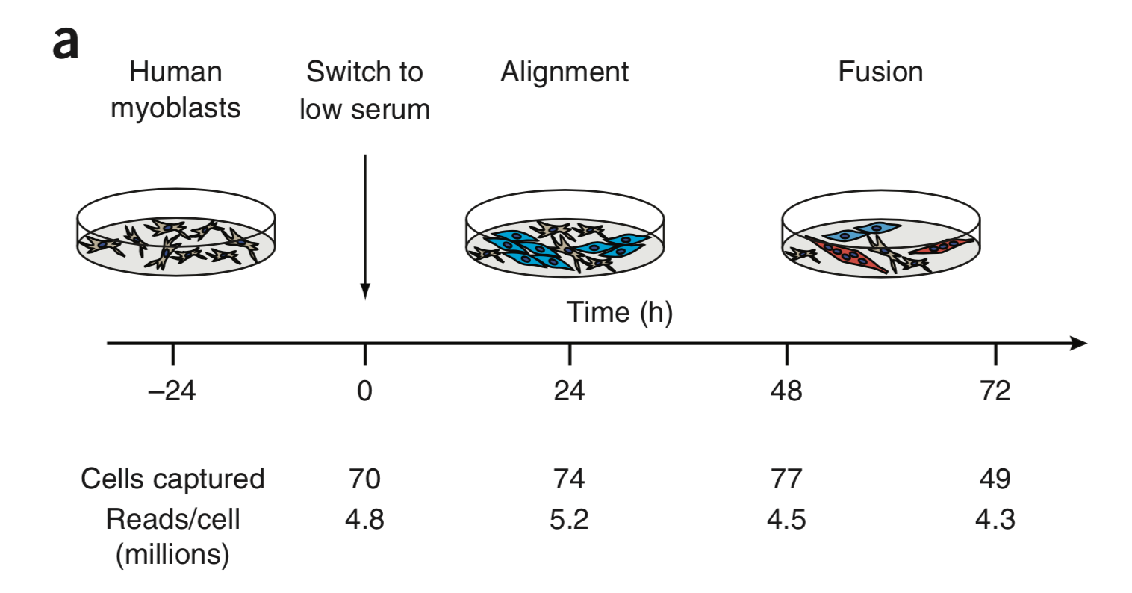
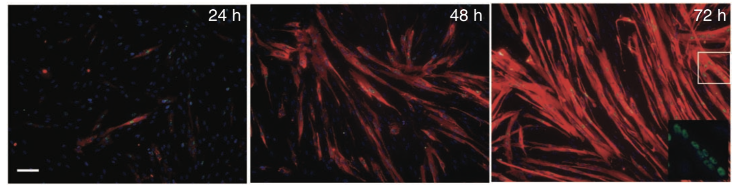
Dataset
Primary human skeletal muscle myoblast cells grown in high-mitogen conditions
Differentiation induced by low-serum medium
Four time points (increments of 24hrs each after differentiation)
isolate RNA from EACH cell and construct a single mRNA-Seq library PER cell
Notes:
The data set they worked with consists of primary human skeletal muscle myoblast cells
They grew these in high mitogen conditions and then induced differentiation by introducing a low serum medium
Then at four distinct time points of 24hr increments they performed RNA-seq at the single cell level

Slide 5
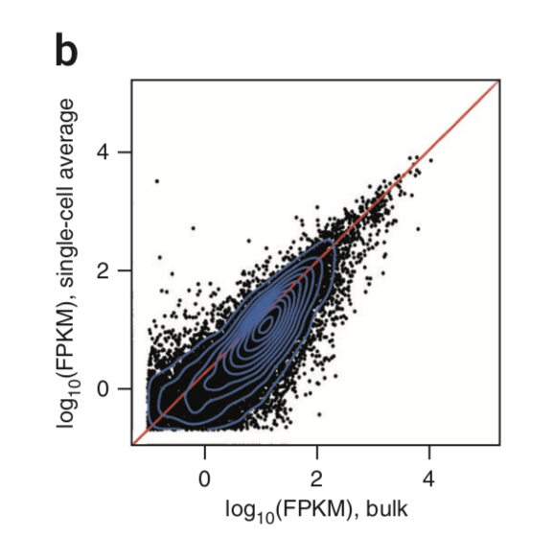
Sanity Check
Confirm that average of the single cell expression profiles collected at the same time correlate with traditional bulk RNA-Seq libraries at those times
Notes:
So first they performed a sanity check to confirm that the average of the single cell expression profiles collected at the same time correlate with traditional bulk RNA-Seq libraries at those times
Seems to check out and there is a high correlation

Slide 6
Background Knowledge for Algorithm
Minimum Spanning Tree (MST)
Independent Component Analysis
Notes:
Before we get into the algorithm I’ll briefly go over MST and ICA which monocle will use
An MST is simply a fully connected graph utilizing minimal edge weight, can be solved in polynomial time through things like Prims or Kruskal’s algorithm
ICA is a means of dimensionality reduction by separating a multivariate signal into additive subcomponents
Assumes that underlying components are non gaussian and independent from eachother
Common example is the cocktail party problem in which we have a lot of people talking in a room and we try to isolate an individual voice or conversation

Slide 7
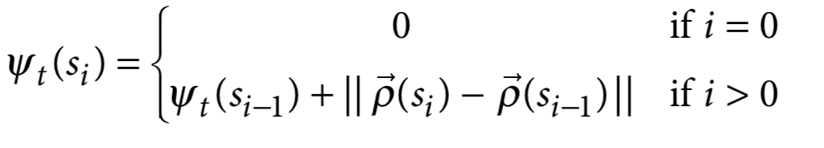
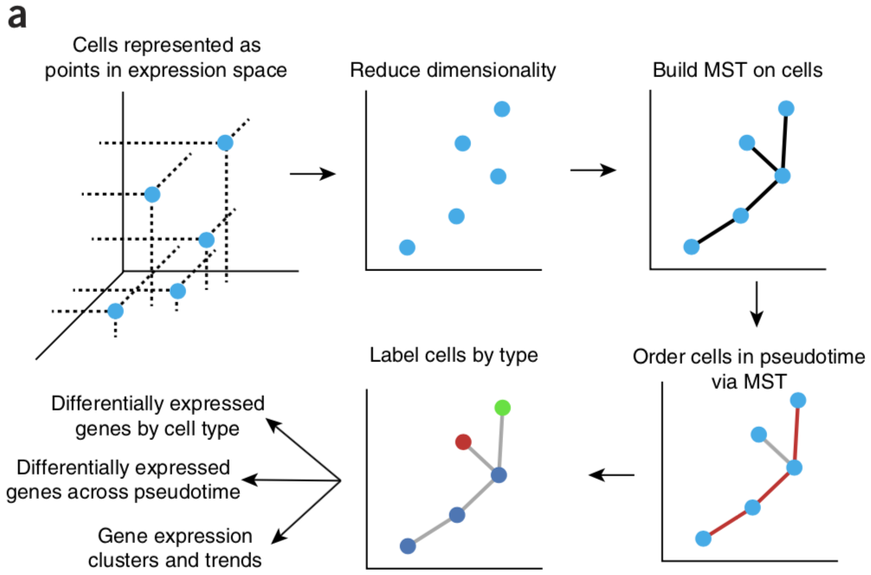
Monocle
Psuedotime - Monocle orders the cells by their progress through differentiation rather than by the time they were collected, maximizing transcriptional similarity between successive pairs of cells
Notes:
-monocle introduces concept of pseudotime (read first bullet)
-(explain formula) pseudotime = 0 for first cell, and second part basically saying cells are close in pseudotime if gene expression is similar
-(click) algorithm runs as follows:
-First represent a cell as a point in high dimensional euclidean space of gene expression, with each gene having its own axis
-idea is that cells close to one another in euclidean space have more similar transcriptional makeup
-Second reduce the dimensionality using independent component analysis
-Third build a minimum spanning tree
-Fourth you then finding the longest path through this MST => corresponds to the longest series of transcriptionally similar cells
-Fifth this sequence is used to produce a ‘trajectory’ of sorts such that an individual cell’s progress through differentiation can be mapped

Slide 8
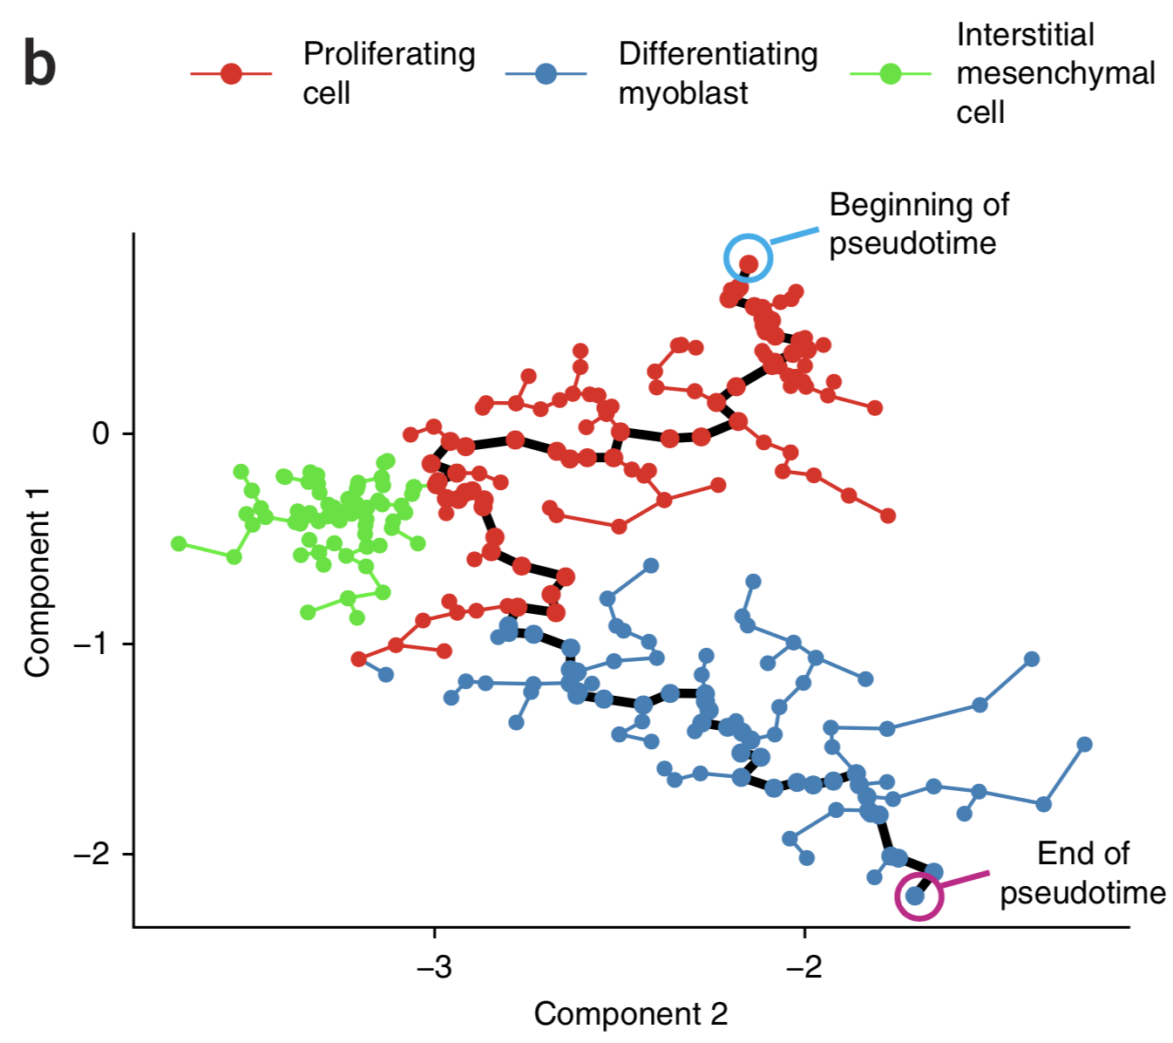
Notes:
Results of monocle algorithm run
Each dot is a cell in the gene expression space identified by ICA
Monocle can separate between proliferating cells in red (which were cells measured before intro of low-serum medium) and differentiating cells in blue (cells collected at t = 24, 48, 72hrs) and interstitial mesenchymal stem cells in green
The MST is shown as the connections between cells, main trajectory in black
So each cell can now be ordered based on how far it is along the differentiation pathway, i.e. MST, or how far it is from the beginning
cells in the denoted blue differentiation phase were positive for markers of muscle differentiation – good positive check that monocle can preserve predicted differentiation factors without having known markers as input to algorithm

Slide 9
How to Deal with Branches
Cell’s ability to diverge along more than one pathway (i.e. branching) accounted for by use of PQ trees to enumerate possible routes
All possible outputs:
12345, 12435, 13245, 13425, 14235, 14325, 52341, 52431, 53241, 53421, 54231, 54321
Notes:
Myoblast have the ability to diverge along more than one pathway (i.e. branching), this is accounted for by use of PQ trees to enumerate possible routes of differentiation
Explain PQ tree (can reverse Q nodes, take any permutation of P nodes)
Monocle exhaustively searches all orderings encoded by the PQ tree and finds one that minimizes total distance in the resulting MST => results in superpolynomial runtime which in theory is pretty slow, but the authors say that in practice it’s not that bad with dataset

Slide 10
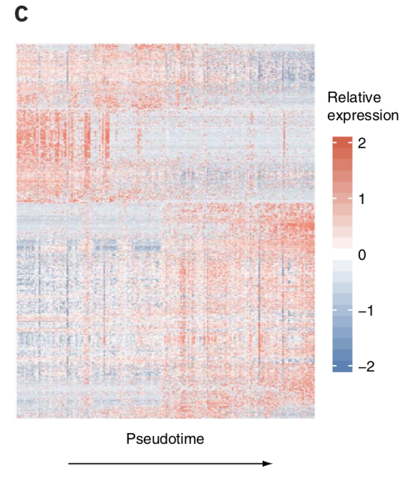
Rows are genes, columns are cells (ordered by monocle)
Ordering shows expression trends consistent with the literature
genes that act at the early and late stages of muscle differentiation showed kinetics that were consistent with expectations
cell-cycle regulators active early in pseudotime and sarcomere components active later
Notes:
Heatmap of gene expression
Rows are genes, columns are cells
monocle orders the cells by pseudotime (i.e. where is the cell in the MST and how far is it from the beginning) (pseudotime has no bearing on real time in hours)
Ordering shows trends consistent with literature
i.e. genes that act at the early and late stages of muscle differentiation showed pseudotemporal kinetics that were highly consistent with expectations, with cell-cycle regulators active early in pseudotime and sarcomere components active later

Slide 11
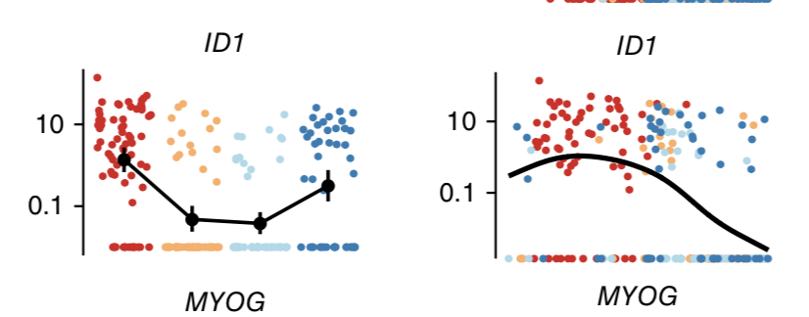
Ordered by time collected
Ordered by Monocle
Notes:
Additional validation of monocle, each dot here is a cell
On the y axis we have expression level of the ID1 gene
On the left, the x axis is order by the time collected, and on the right the x axis ordered by monocle
The monocle ordered graph shows an ID1 expression trend more consistent with literature
So they can suggest that ordering of cells increases temporal resolution of transcriptional dynamics

Slide 12
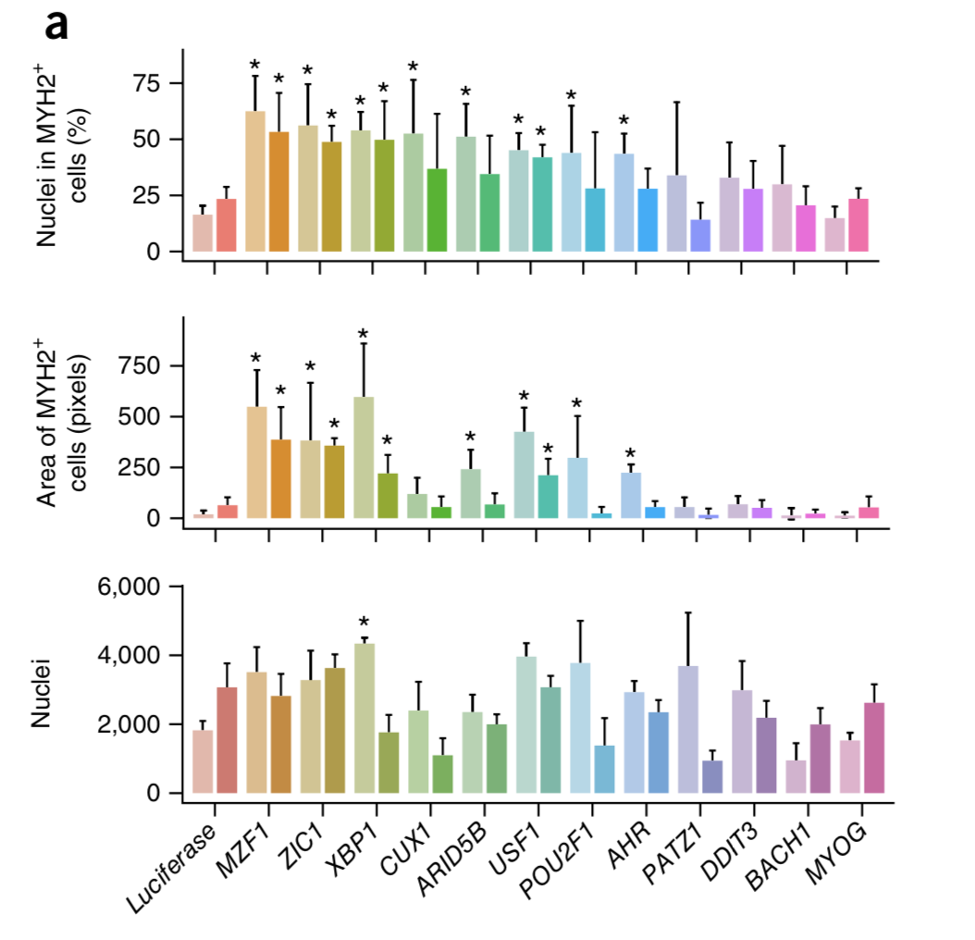
Monocle to Discover New Transcription Factors
Notes:
Monocle also used to discover new transcription factors relevant to myoblast differentiation
From key stages in differentiation (switch points in pseudotime), genes with high expression levels were selected
from this, they then looked at the subset of genes that were not previously associated with differentiation in the literature, and performed a knockdown validation through shRNA (short hairpin RNA)
Results of knockdown are shown, with readouts being cell area and number of nuclei
Discovered that 8 of these are relevant to the differentiation process (regular control expression is not shown; “*” was used to indicate “significant” knockdown effect by the student’s t-test)

Slide 13
Summary
Monocle is a way of ordering cells by their progress through differentiation, not relying on a priori knowledge (unsupervised)
8 new TFs discovered and validated for myoblast differentiation

Slide 14
Caveats
During knockdown validation, control expression levels are not shown
Deriving two endpoints of pseudotime is not clear in methods, ill-defined and informal notation
Theoretically slow runtime
Gene selection bias - experimenter must pick which genes to seed to maximize independence
ICA reduction assumes signals are statistically independent, not always the case for genes
Notes:
Bullet 1
Bullet 2 (but I think it’s just the two ends of the longest path through the MST)
Bullet 3
In practice single cell RNA seq will detect expression of only a subset of genes in each cell
Choosing which genes to represent in Euclidean space introduces bias
Bullet 4

Slide 15
Future Directions
Apply to other data sets and different cell types, and begin mapping other complex temporal transcriptional mechanisms

Slide 16
Questions

